Slide 1
Module 03
Software Estimation Metrices

Slide 2
Process and Project Metrics
Introduction
Metrics in the Process Domain
Metrics in the Project Domain
Software Measurement
Integrating Metrics within the Software Process

Slide 3
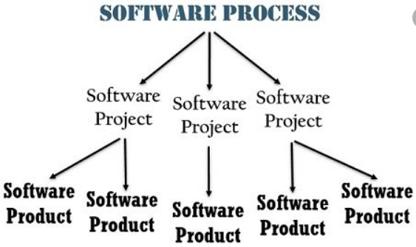


Slide 4
What are Metrics?
Software process and project metrics are quantitative measures
They are a management tool
They offer insight into the effectiveness of the software process and the projects that are conducted using the process as a framework
Basic quality and productivity data are collected
These data are analyzed, compared against past averages, and assessed
The goal is to determine whether quality and productivity improvements have occurred
The data can also be used to pinpoint problem areas
Remedies can then be developed and the software process can be improved

Slide 5
A Quote on Measurement
“When you can measure what you are speaking about and express it in
numbers, you know something about it; but when you cannot measure,
when you cannot express it in numbers, your knowledge is of a meager
and unsatisfactory kind; it may be the beginning of knowledge, but you
have scarcely, in your thoughts, advanced to the stage of science.”
LORD WILLIAM KELVIN (1824 – 1907)

Slide 6
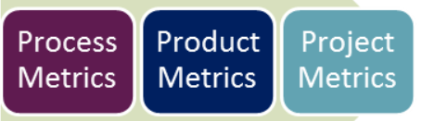
Types of metrics

Slide 7
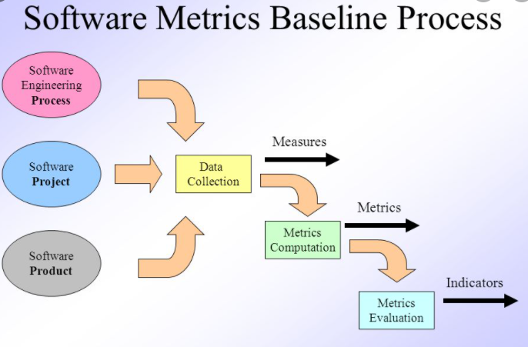

Slide 8
Uses of Measurement
Can be applied to the software process with the intent of improving it on a continuous basis
Can be used throughout a software project to assist in
    Estimation,
    Quality control,
    Productivity assessment,
    Project control
Can be used to help assess the quality of software
    Work products
    To assist in tactical decision making as a project proceeds

Slide 9
Reasons to Measure
To characterize in order to
  Gain an understanding of processes, products, resources, and environments
  Establish baselines for comparisons with future assessments
To evaluate in order to
  Determine status with respect to plans
To predict in order to
  Gain understanding of relationships among processes and products
  Build models of these relationships
To improve in order to
  Identify roadblocks, root causes, inefficiencies, and other opportunities for improving product quality and process performance

Slide 10
Metrics in the Process Domain

Slide 11
Metrics in the Process Domain
Process metrics are collected across all projects and over long periods of time
They are used for making strategic decisions
The intent is to provide a set of process indicators that lead to long-term software process improvement
The only way to know how/where to improve any process is to
  Measure specific attributes of the process
  Develop a set of meaningful metrics based on these attributes
  Use the metrics to provide indicators that will lead to a strategy for improvement
(More on next slide)

Slide 12
Metrics in the Process Domain
(continued)
We measure the effectiveness of a process by deriving a set of metrics based on outcomes of the process such as
  Errors uncovered before release of the software
  Defects delivered to and reported by the end users
  Work products delivered
  Human effort expended
  Calendar time expended
  Conformance to the schedule
  Time and effort to complete each generic activity

Slide 13
Etiquette of Process Metrics
Use common sense and organizational sensitivity when interpreting metrics data
Provide regular feedback to the individuals and teams who collect measures and metrics
Don’t use metrics to evaluate individuals
Work with practitioners and teams to set clear goals and metrics that will be used to achieve them
Never use metrics to threaten individuals or teams
Metrics data that indicate a problem should not be considered “negative”
  Such data are merely an indicator for process improvement
Don’t obsess on a single metric to the exclusion of other important metrics

Slide 14
Metrics in the Project Domain

Slide 15
Metrics in the Project Domain
Project metrics enable a software project manager to
  Assess the status of an ongoing project
  Track potential risks
  Uncover problem areas before their status becomes critical
  Adjust work flow or tasks
  Evaluate the project team’s ability to control quality of software work products
Many of the same metrics are used in both the process and project domain
Project metrics are used for making tactical decisions
  They are used to adapt project workflow and technical activities

Slide 16
Use of Project Metrics
The first application of project metrics occurs during estimation
  Metrics from past projects are used as a basis for estimating time and effort
As a project proceeds, the amount of time and effort expended are compared to original estimates
As technical work commences, other project metrics become important
  Production rates are measured (represented in terms of models created, review hours, function points, and delivered source lines of code)
  Error uncovered during each generic framework activity (i.e, communication, planning, modeling, construction, deployment) are measured
(More on next slide)

Slide 17
Use of Project Metrics (continued)
Project metrics are used to
  Minimize the development schedule by making the adjustments necessary to avoid delays and mitigate potential problems and risks
  Assess product quality on an ongoing basis and, when necessary, to modify the technical approach to improve quality
In summary
  As quality improves, defects are minimized
  As defects go down, the amount of rework required during the project is also reduced
  As rework goes down, the overall project cost is reduced

Slide 18
Software Measurement

Slide 19
Categories of Software Measurement
Two categories of software measurement
  Direct measures of the
    Software process (cost, effort, etc.)
    Software product (lines of code produced, execution speed, defects reported over time, etc.)
  Indirect measures of the
    Software product (functionality, quality, complexity, efficiency, reliability, maintainability, etc.)
Project metrics can be consolidated to create process metrics for an organization

Slide 20
Size-oriented Metrics
Derived by normalizing quality and/or productivity measures by considering the size of the software produced
Thousand lines of code (KLOC) are often chosen as the normalization value
Metrics include
  Errors per KLOC - Errors per person-month
  Defects per KLOC - KLOC per person-month
  Dollars per KLOC - Dollars per page of documentation
  Pages of documentation per KLOC

Slide 21
Size-oriented Metrics (continued)
Size-oriented metrics are not universally accepted as the best way to measure the software process
Opponents argue that KLOC measurements
  Are dependent on the programming language
  Penalize well-designed but short programs
  Cannot easily accommodate nonprocedural languages
  Require a level of detail that may be difficult to achieve

Slide 22
Function-oriented Metrics
Function-oriented metrics use a measure of the functionality delivered by the application as a normalization value
Most widely used metric of this type is the function point:
FP = count total * [0.65 + 0.01 * sum (value adj. factors)]
Function point values on past projects can be used to compute,
Example: the average number of lines of code per function point (e.g., 60)

Slide 23
Function Point Controversy
Like the KLOC measure, function point use also has proponents and opponents
Proponents claim that
  FP is programming language independent
  FP is based on data that are more likely to be known in the early stages of a project, making it more attractive as an estimation approach
Opponents claim that
  FP requires some “sleight of hand” because the computation is based on subjective data
  FP has no direct physical meaning…it’s just a number

Slide 24
Reconciling LOC and FP Metrics
Relationship between LOC and FP depends upon
  The programming language that is used to implement the software
  The quality of the design
FP and LOC have been found to be relatively accurate predictors of software development effort and cost
  However, a historical baseline of information must first be established
LOC and FP can be used to estimate object-oriented software projects

Slide 25
Home work ☺
Find/Create the table on the which provides a rough estimate of the
Average LOC to one FP in various programming languages

Slide 26
MCQ
Q1) 1. Which of the following is the task of project indicators:
a) help in assessment of status of ongoing project
b) track potential risk
c) help in assessment of status of ongoing project & track potential risk
d) none of the mentioned
2. Which of the following is an indirect measure of product?
a) Quality
b) Complexity
c) Reliability
d) All of the Mentioned
3. In size oriented metrics, metrics are developed based on the ___________________
a) number of Functions
b) number of user inputs
c) number of lines of code
d) amount of memory usage

